Slide 1
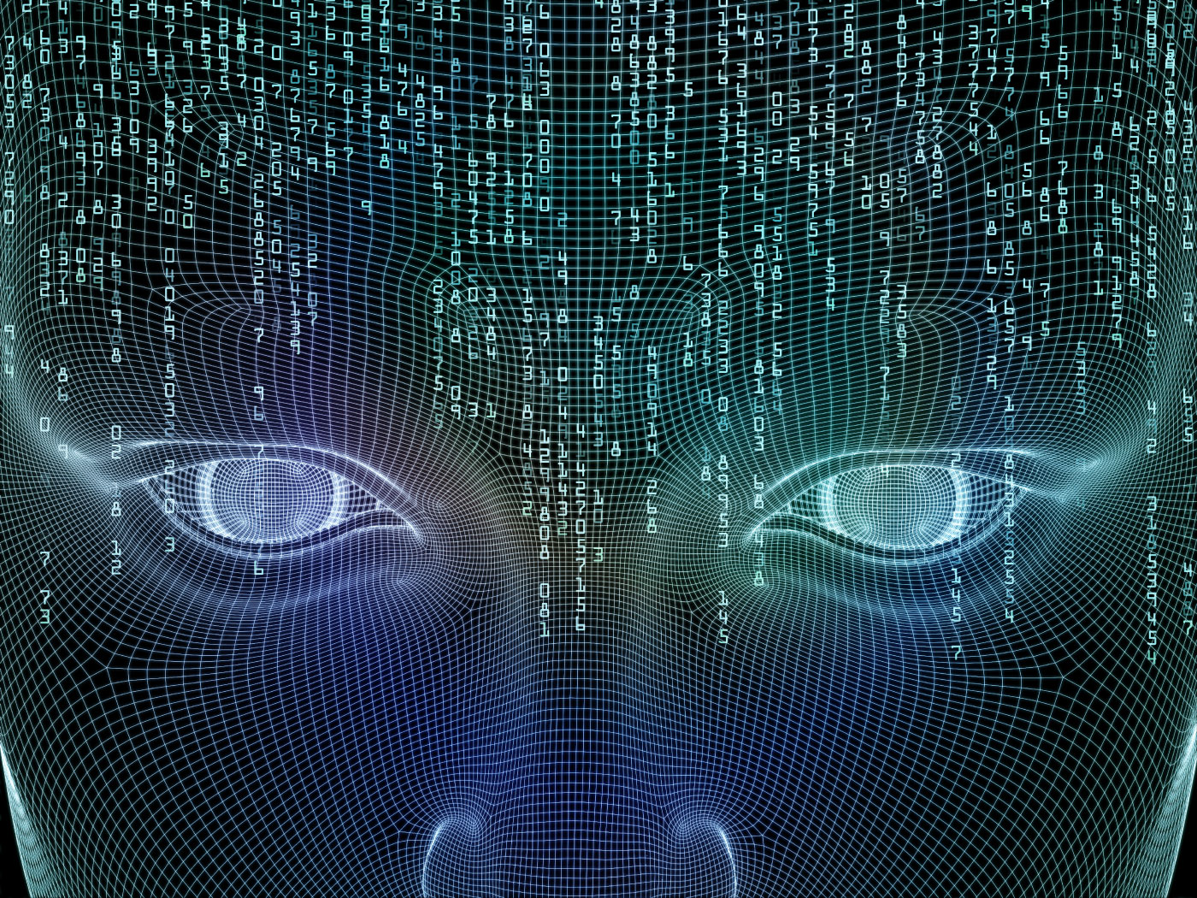

Neural Networks
Ahmed Meshref

Slide 2


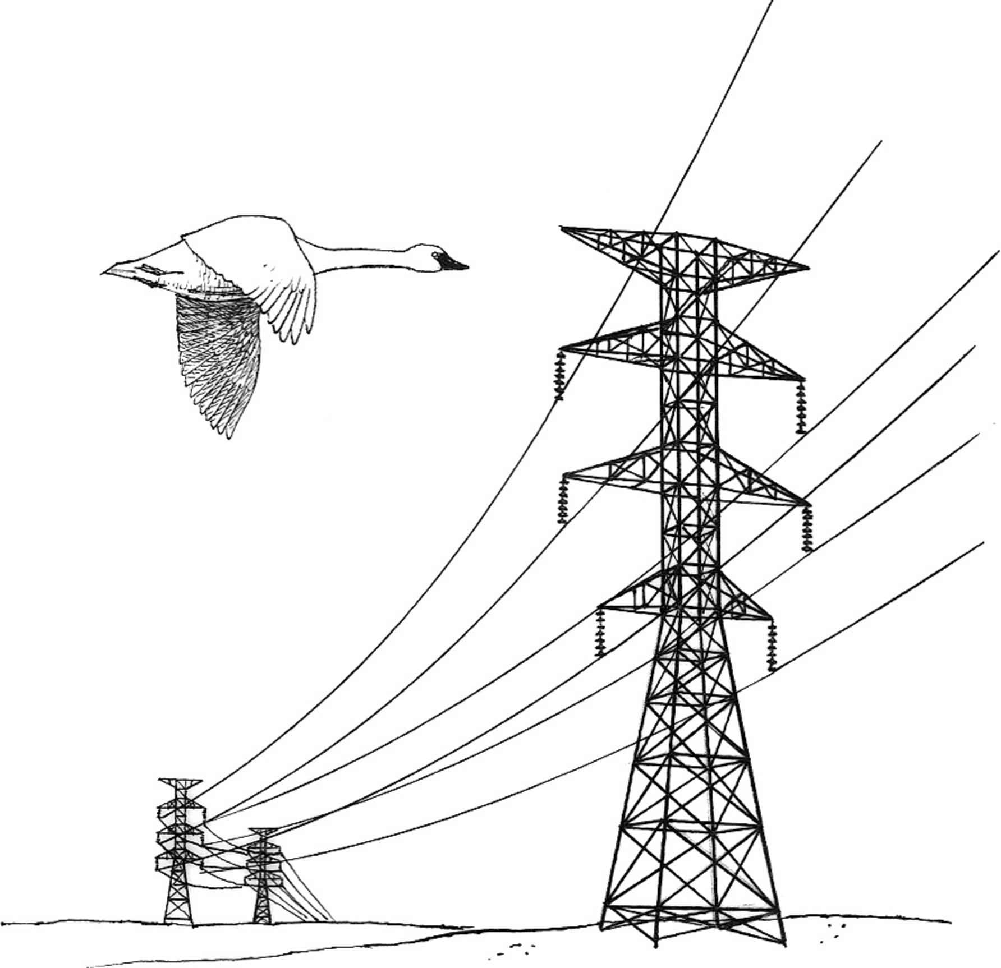
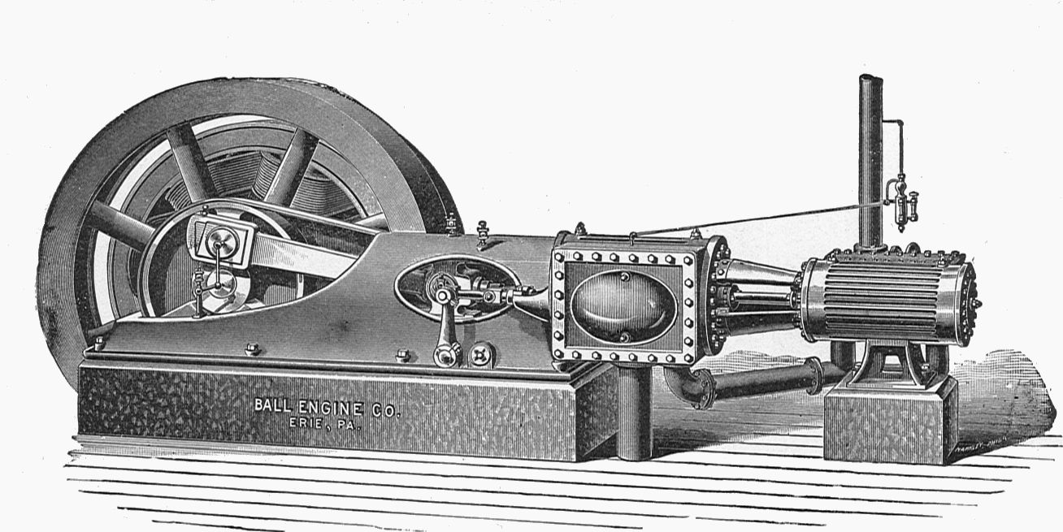
THE 4TH INDUSTRIAL REVOLUTION IS HERE
AI
+$16T
Digital
Electricity
Machines
NOW
1960
1900
1760

Slide 3
WHAT IS AI
Take guessing out of decision-making
Decisions based on past evidence
A lot faster than humans can

Slide 4
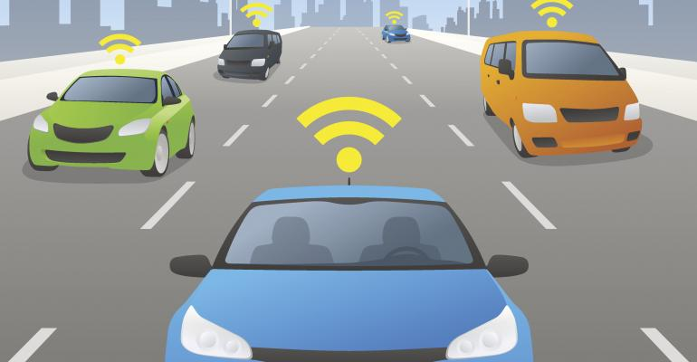


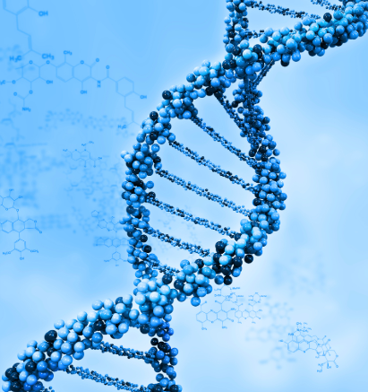
AI TRANSFORMING THE WORLD
PROBLEMS WE COULDN’T TACKLE BEFORE
Discovery and cure of new diseases like amyotrophic lateral sclerosis
Safer driving. According to Bloomberg 25% of all cars on the road will be fully autonomous by 2036
Smarter use of energy
Preserving the environment and reversing the impact of climate change

Slide 5
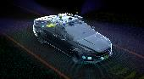


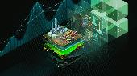
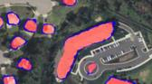
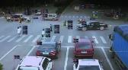


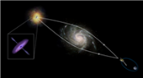

AI IS REVOLUTIONIZING INDUSTRIES – CASES
Ask what AI can’t do
AUTOMOTIVE
Autonomous Driving
Object detection
Mobility as service and connected vehicle
INDUSTRIAL
Remaining Useful Life Estimation
Failure Prediction
Demand Forecasting
FINANCIAL SERVICES
Claim fraud
Customer service chatbots/routing
Risk evaluation
OIL & GAS
Sensor Data Tag Mapping
Anomaly Detection
Robust Fault Prediction
GOV’T & DEFENSE
Identifying threats
Satellite imagery & Optimize logistics management
Support emergency response teams
SMART CITIES
intelligent video analytics
Optimize city resources from parking management to law enforcement and city services
HEALTHCARE
Improve Clinical Care
Drive Operational Efficiency
Speed Up Drug Discovery
RETAIL
Supply Chain & Inventory Management
Price Management / Markdown Optimization
HIGHER EDUCATION/RESEARCH
Climate & Melting of Sea Ice Prediction
Design more effective drugs and new treatments for diseases
Predictive analytics in the sports industry
TELCO
Detect Network/Security Anomalies
Forecasting Network Performance
Network Resource Optimization (SON)

Slide 6
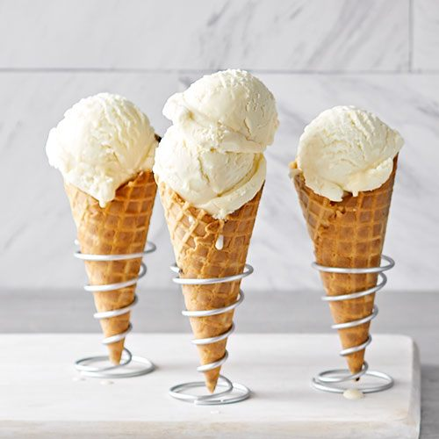
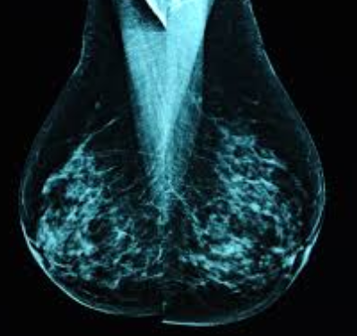
AI VS ML VS DL
ARTIFICIAL INTELLIGENCE
Any application using past data evidence to help computers answer future questions.
As computers, they can perform many more questions much faster than humans
MACHINE LEARNING
A lot of data + simple layer functions like linear regressions = teach computer to answer simple questions
DEEP LEARNING
A ton of data + complex layer functions = teach company to answer more complex questions, closer to humans
Answer many more questions much faster and better
How will ice-cream sales vary by the day of the week?
Look at this MRI scan, does this patient have cancer?

Slide 7


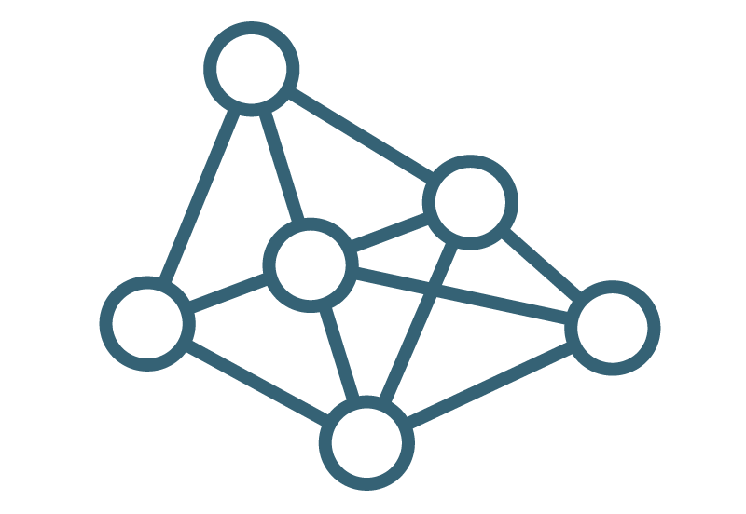
DEEP LEARNING TOPICS
SPEECH/AUDIO PROCESSING
COMPUTER VISION
NATURAL LANGUAGE PROCESSING

Slide 8
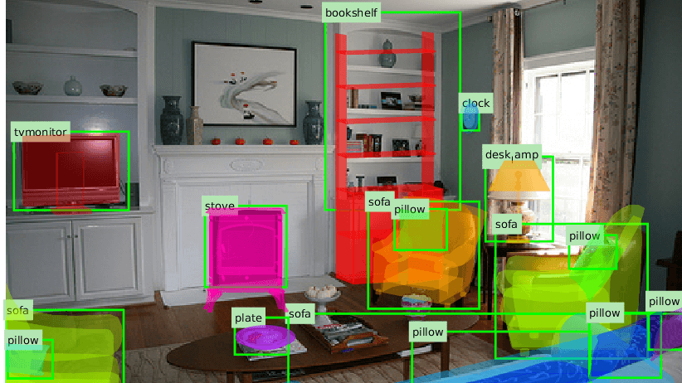

DEEP LEARNING APPLICATIONS
Object Detection
Speech Recognition

Slide 9
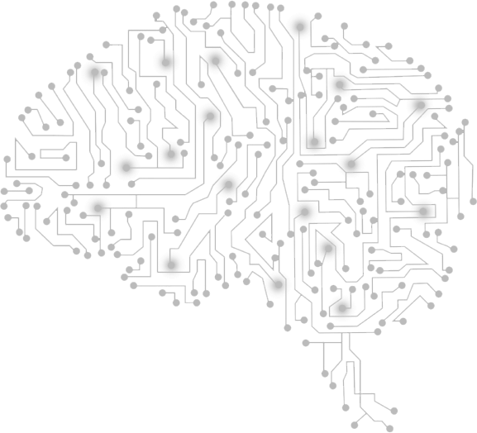
NEURAL NETWORKS

Slide 10
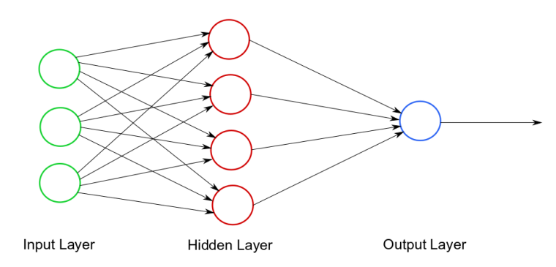
ARTIFICIAL NEURAL NETWORKS
The heart of deep learning
Deep Learning uses different architecture of Neural Networks to implement Machine Learning

Slide 11
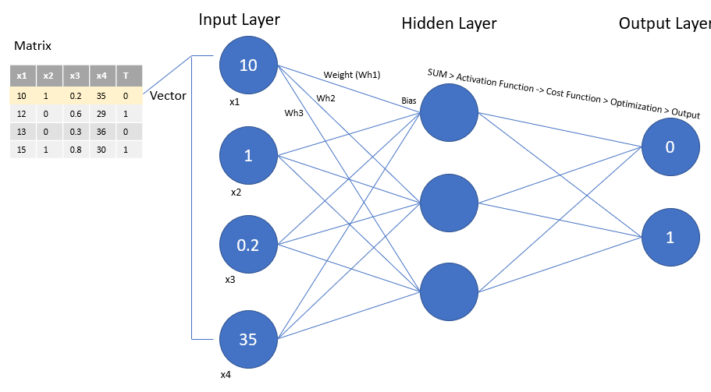
ARTIFICIAL NEURAL NETWORKS
The heart of deep learning
Deep Learning uses different architecture of Neural Networks to implement Machine Learning
Plain Vanilla architecture
Each layer is connect to the other with different weight matrix represented on each arrow that indicates the importance of each neuron input to the output.

Slide 12
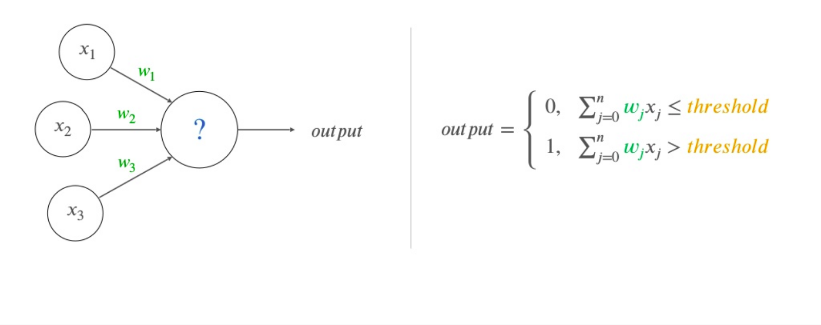
HIDDEN LAYERS
Let’s see how the hidden layers work
Say, x1, x2, x3 = 1, 1, 0. With weights as follows w1, w2, w3 = 1, 1, 0. Assume that our threshold = 5
performing dot product we will get:
1- w.x = 2
2- 2 > 5
3= Output = 0

Slide 13
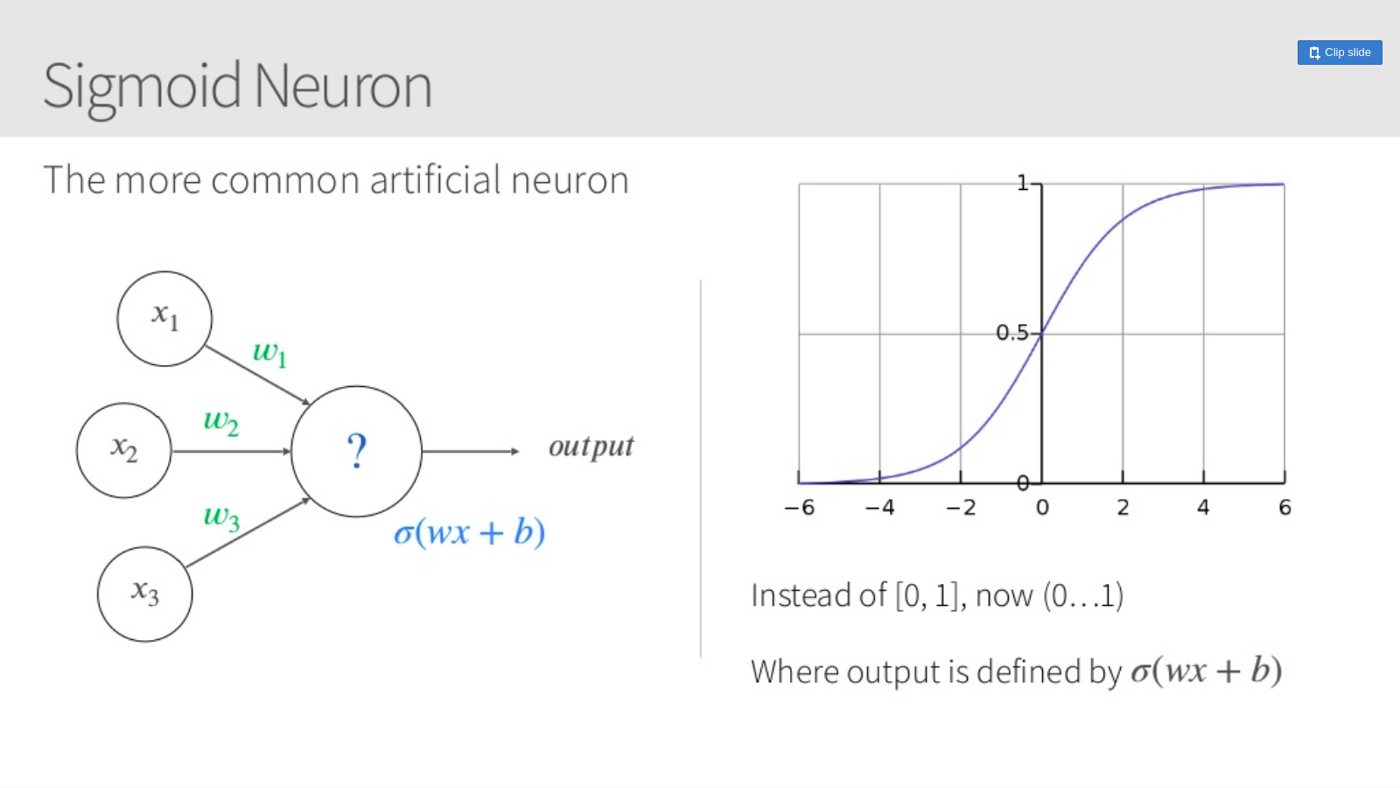
ACTIVATION FUNCTION
Adding the bias (b) is important in controlling the neuron. Also, its value allows us to shift the activation function to the left or right, which may be critical for successful learning.

Slide 14
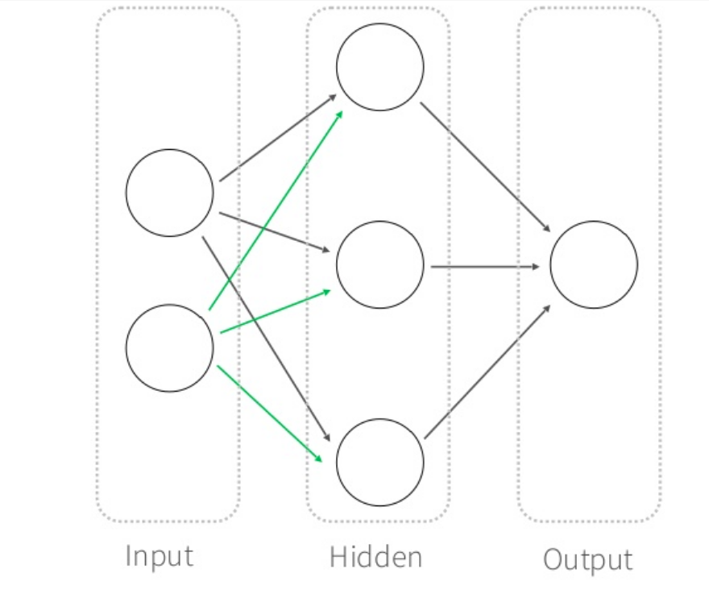
EXAMPLE

Slide 15
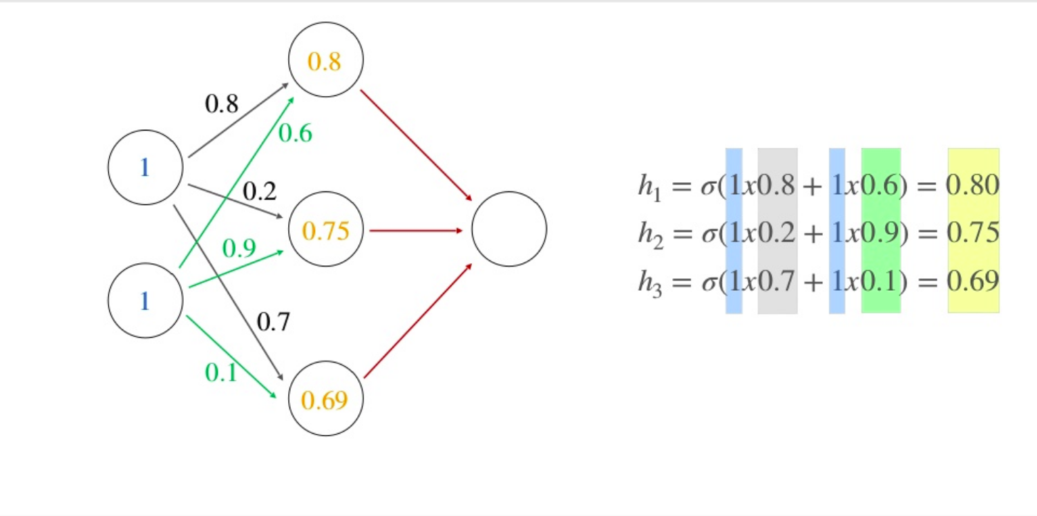
EXAMPLE

Slide 16
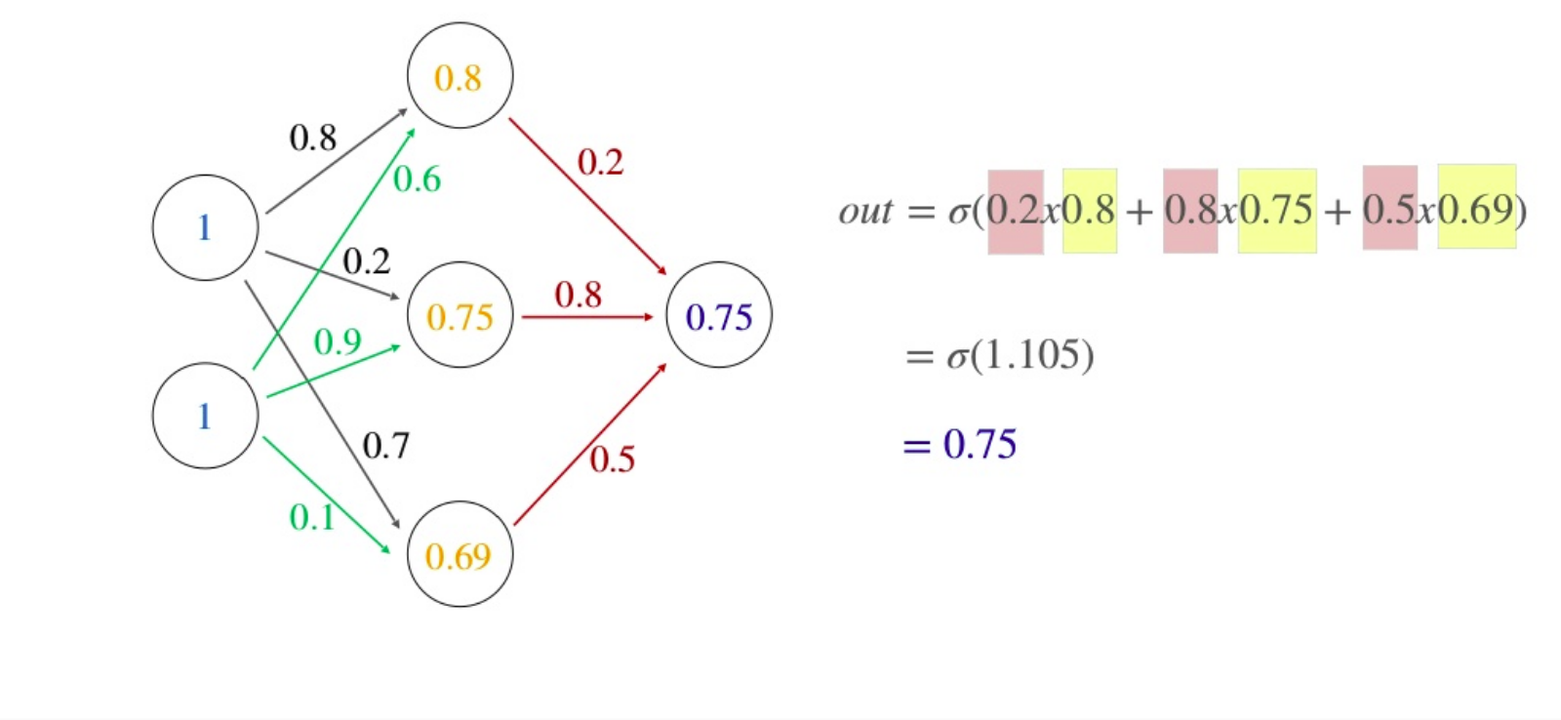
EXAMPLE

Slide 17
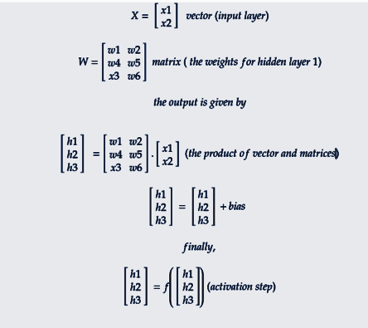
COMPUTER OPERATION TO PERFORM FFNN

Slide 18
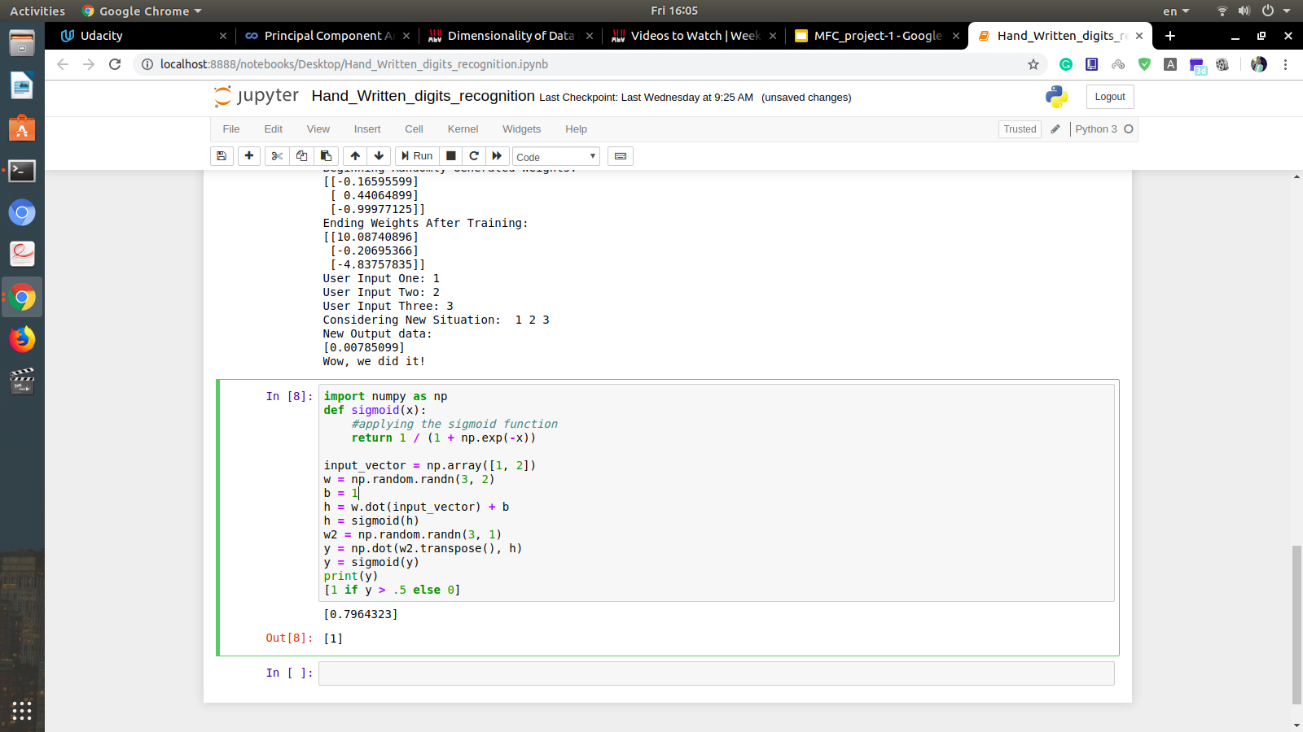
CODE EXAMPLE

Slide 19
OPTIMIZATION

Slide 20
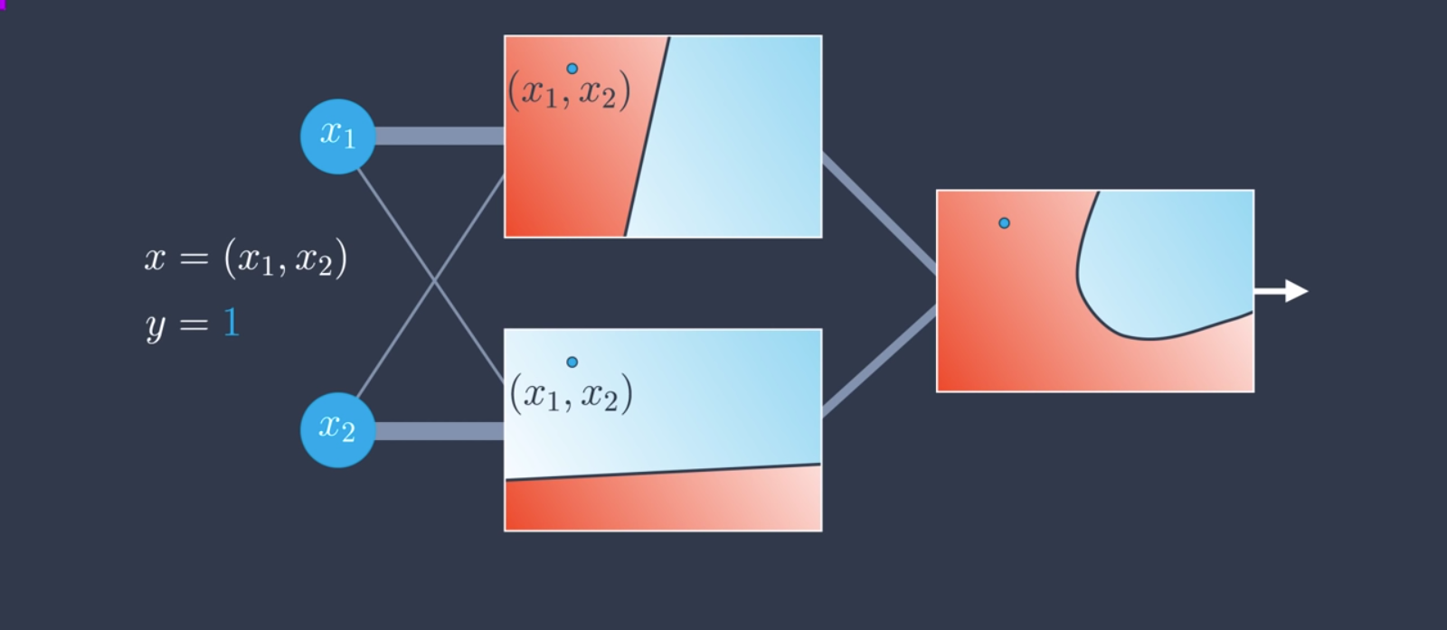
ERRORS
All of the previous process is called Feedforward which indicates the process of feeding our Neural Network with the data and plugin that into the sigmoid function to get a probability for the output between 0 and 1
Q: What if we misclassified our points?

Slide 21
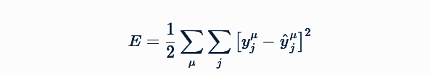
FORMULATE A PROBLEM
The network needs to make predictions as close as possible to the real values. To measure this, we use a metric of how wrong the predictions are, the error to improve the neural network weights
Mean Square Error Function:
Where
1- y_hat represents the prediction and y is the true value.
2- The variable j represents the output units of the network. So this inside sum is saying for each output unit, find the difference between the true value y and the predicted value from the network ​then square the difference, then sum up all those squares.
3- The variable μ indicates loop over all of the data point that we feed our neural network with.
To reach our gool, we need to minimize the error and we will user a method called backpropagation to do that.

Slide 22
BACKPROPAGATION
Big picture steps:
Do a feedforward operation.
Comparing the output of the model with the desired output.
Calculating the error.
Running the feedforward operation backwards (backpropagation) to spread the error to each of the weights.
Use this to update the weights, and get a better model.
Continue this until we have a model that is good.

Slide 23
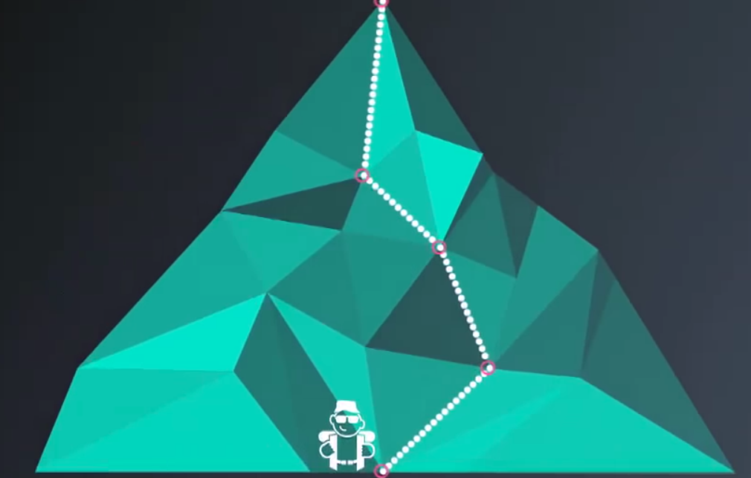
BACKPROPAGATION
Backpropagation is the optimization of the neural network and it is simply optimizing the error function to get its minimum.
Thinking of that mountain as out Error function plotted, then from the top of it, reaching the bottom of the mountain (the steeps point of the mountinue) is our goal and the way to do that is by looking around us each time and finding the next steeps point (min error). So, we can find the best direction by calculating the gradient of the squared error function

Slide 24
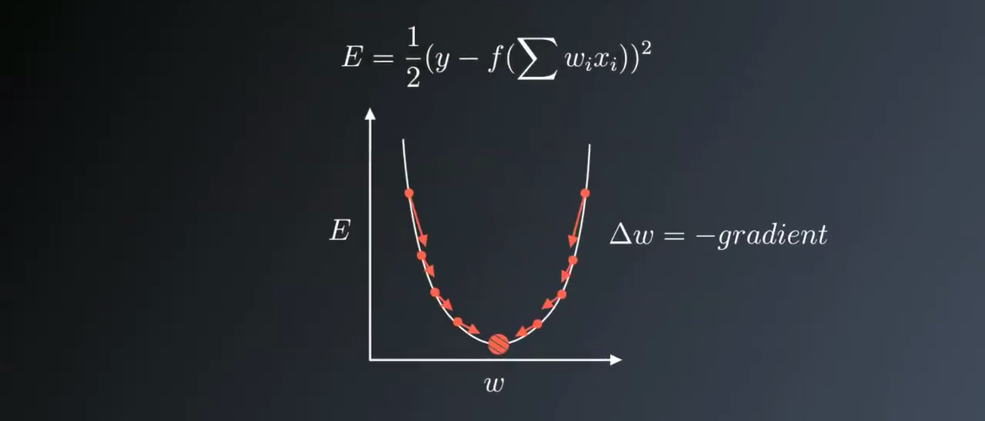
BACKPROPAGATION WITH GRADIENT DESCENT
Gradient descent is an optimization algorithm that minimizes the error of each weight in our network to improve the results.
As shown, the error function is a function of each weight, so we need to get the partial derivative of the error function corresponding to each weight to reach the minimum of the error at that weight.

Slide 25
CHAIN RULE
Update the value of w1
Our error function is a function of y_output, and our y_output is a function of h, and our h is a function of the weight. So, to get the partial derivative of the error function corresponding to the weight, we need to use the chain rule.

Slide 26
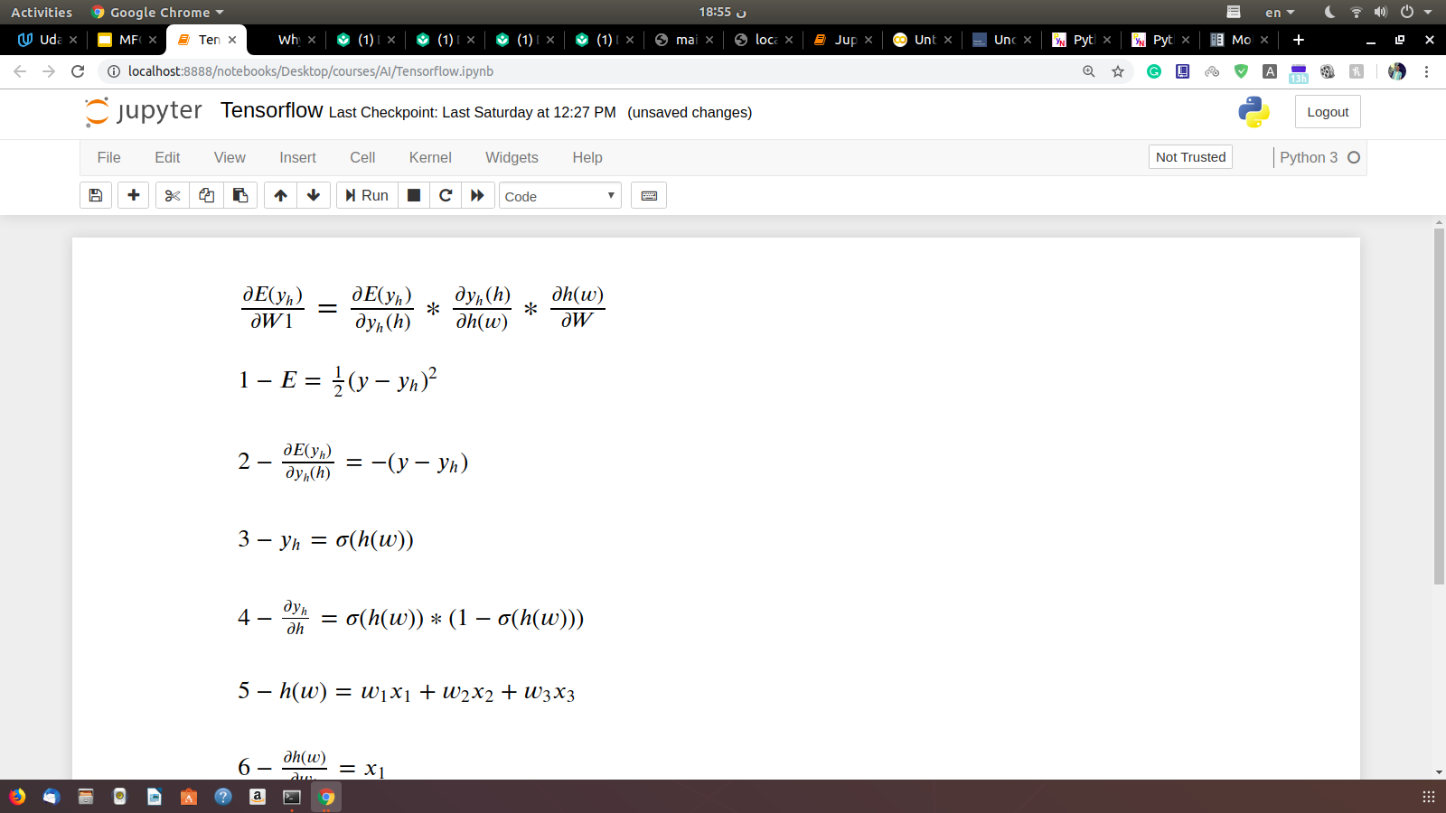
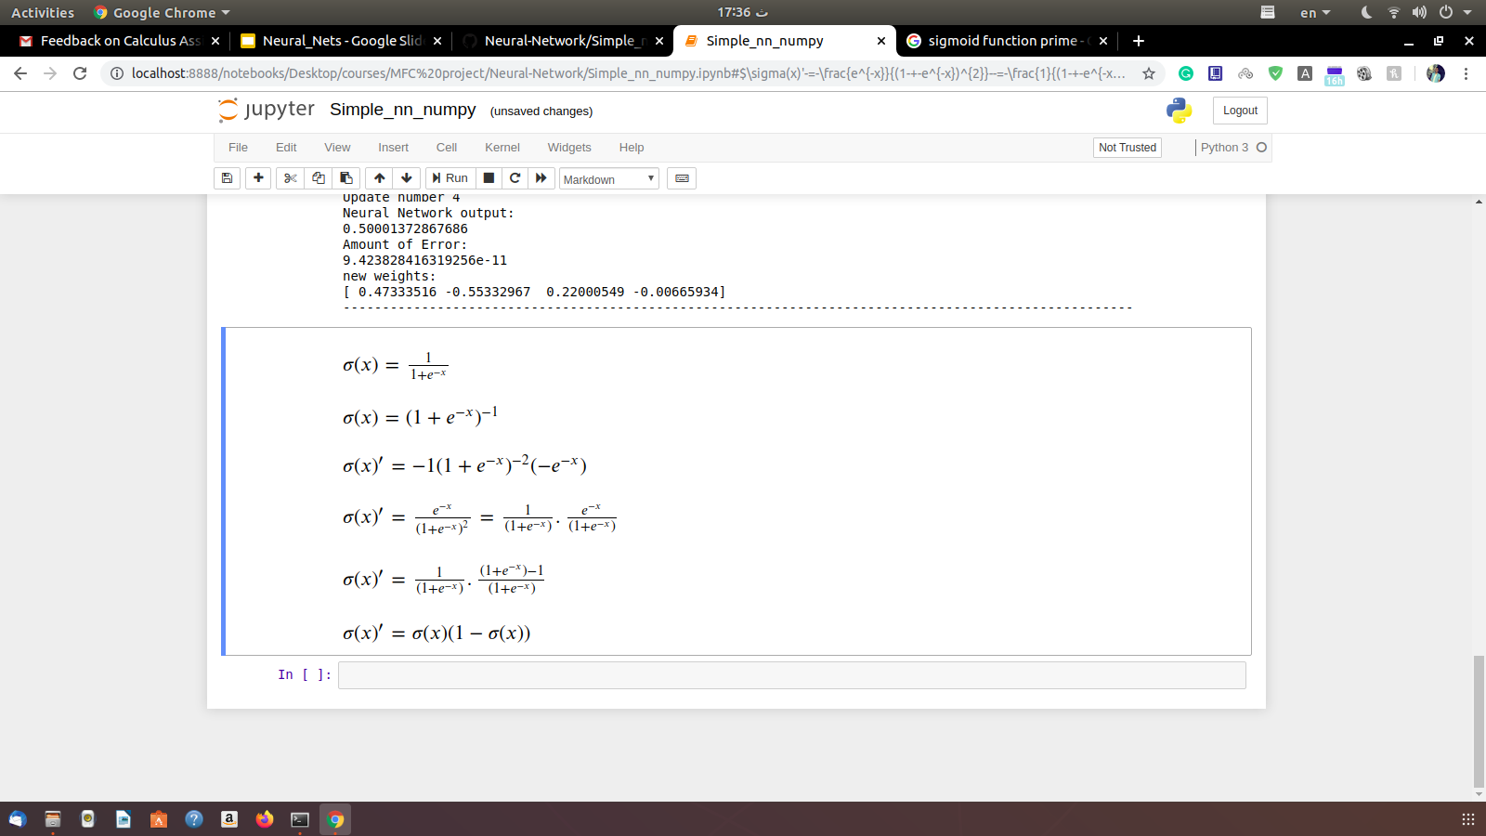
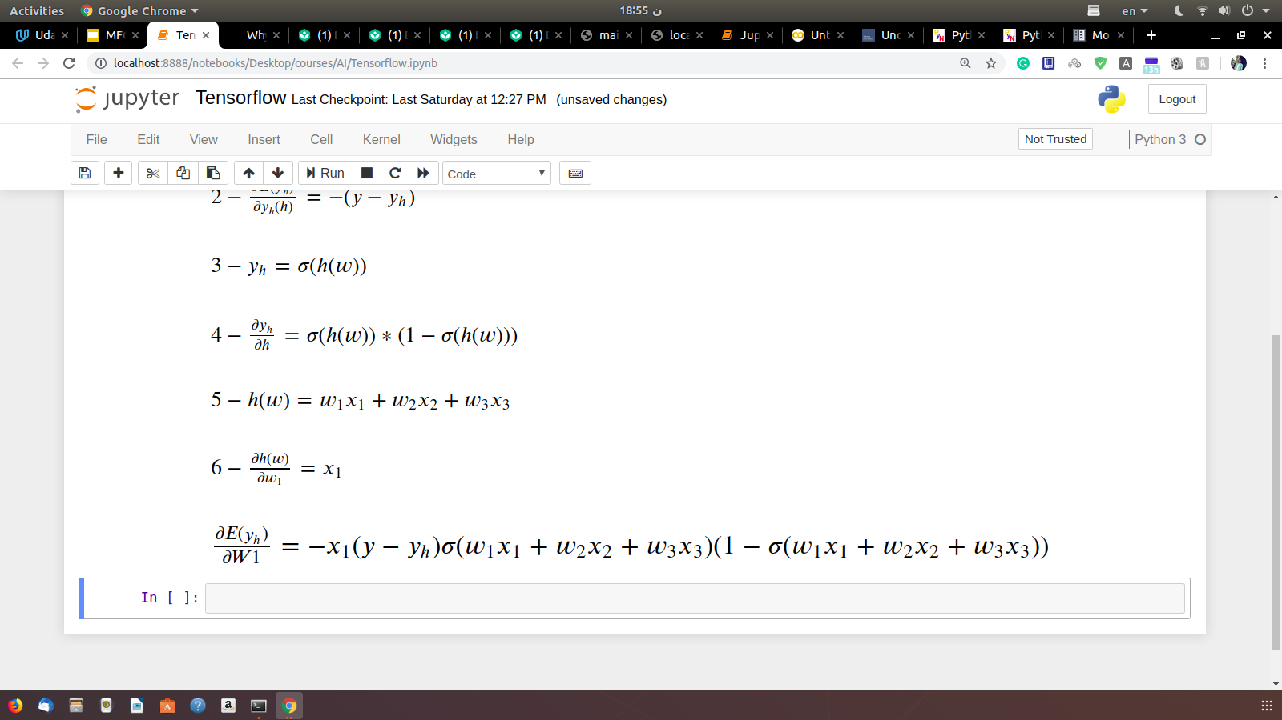
CHAIN RULE APPLIED
Note

Slide 27
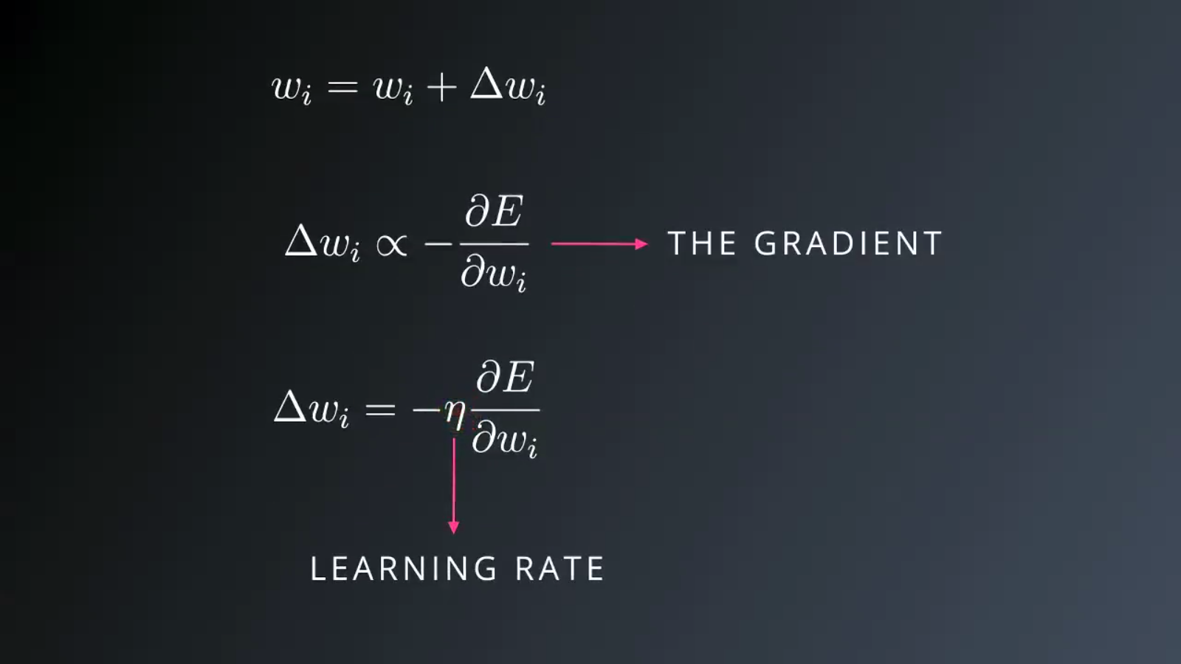
UPDATING THE WEIGHTS
So, we update each weight with the negative value of the gradient which points towards the minimum multiplied by the learning rate (a length) that determines the step we take each time we update to reach the minimum.
The value of learning rate shouldn’t be: 1- too big because we won’t saturate in the global or local minimum
2- too small because it will make the process of reaching the minimum (converge) slow.

Slide 28
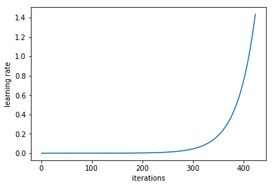
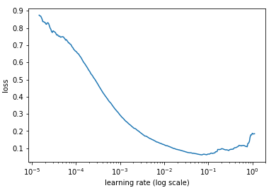
GOOD WAY TO CALC LEARNING RATE
Learning rate is a hyper-parameter that controls how much we are adjusting the weights of our network with respect the loss gradient.
A way of calculating a good learning rate is to choose very low learning rate and increasing it (either linearly or exponentially) at each iteration of the traning. Then record the learning rate at each iteration and plot the learning rate (log scale) against the loss function and we can see that point where our loss stopped to decrease and started to increase. This point indicates optimal learning rate (in the example below the good learning rate is between 0.001 to 0.01)
Learning rate increases after each mini-batch

Slide 29
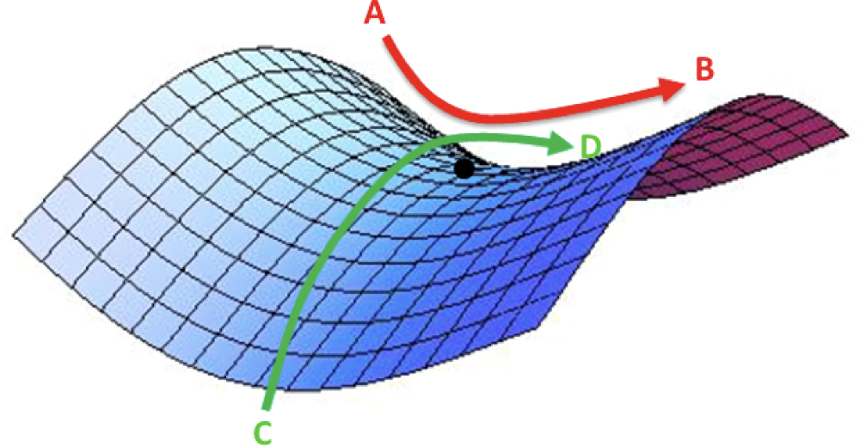
LIMITATION OF CALCULUS
Sometimes, minimizing the loss becomes hard if we reach a saddle point like the one indicated in the graph because the gradient at this point is 0 which make is the effect of learning rate disappears and the weights values will be fixed.
For that, we can use another technique called stochastic gradient descent. The SGD simply trains cycles, during each cycle, it chooses different weights and restarts the learning rate and does the same process as GD. By that, we can plot the error at different weights which helps to choose the actual global or local minimum in a shorter period of time (optimization).

Slide 30
LIMITATION OF CALCULUS
The main objective of training a neural network is have a final model that performs well both on the data that we used to train it and the new data on which the model will be used to make predictions (good fit model). So, we split our data to train/split data and calculate the error on both data.
Another scenario that might happen is over-optimizing the weights which is called overfitting the training date. Overfitting means that the error on the training set is driven to a very small value, but when new data is presented to the network the error is large. Also, the model can underfit which means it can’t learn.
Root of the problem:
1- The model has too little capacity so it won’t learn the problem (underfitting).
2- The model has too much capacity so it can learn the problem too well and overfit the training dataset (overfitting).
Both cases will result in a model that does not generalize well on the test examples.
Note: Capacity refers to the ability of a model to fit a variety of functions for mapping the input to output..

Slide 31
SOLUTION FOR UNDER AND OVER FITTING
We can address underfitting by increasing the capacity of the model. THis can be done via changing the structure of the model, such as adding more layers and/or more nodes to layers.
For overfitting, we can:
Increase the number of training data.
changing the capacity of the network by changing the number of weights and hidden layers or changing the values of the weights (SGD).
Regorluzation and one of its forms is keeping the weights values small to not have any bias via penalize the model during training based on the magnitude of the weights (weight decay).

Slide 32

CODE
Click on github icon below for the code

Slide 33
APPLICATION

Slide 34
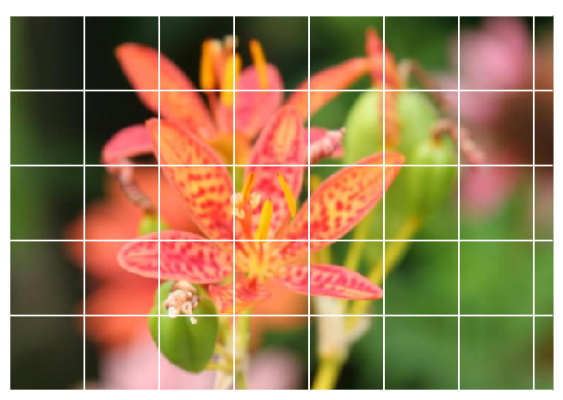
Image CLASSIFIER
Let's train deep learning model on images training set and use it to classify new images.
Problem: given a flower picture like the one down, identify its type among 4 different types of flowers.

Slide 35
CODE
The project with its explanation are in the following github account. Click here

Slide 36


IMAGE CLASSIFIER APPLICATIONS
Automated Image grouping
Visual Search for Improved Product Discoverability
This is a Deep Learning application that classifies similar images together in the cloud.
Built at the top of image grouping and used in the online stores to show similar products the ones you like.

Slide 37
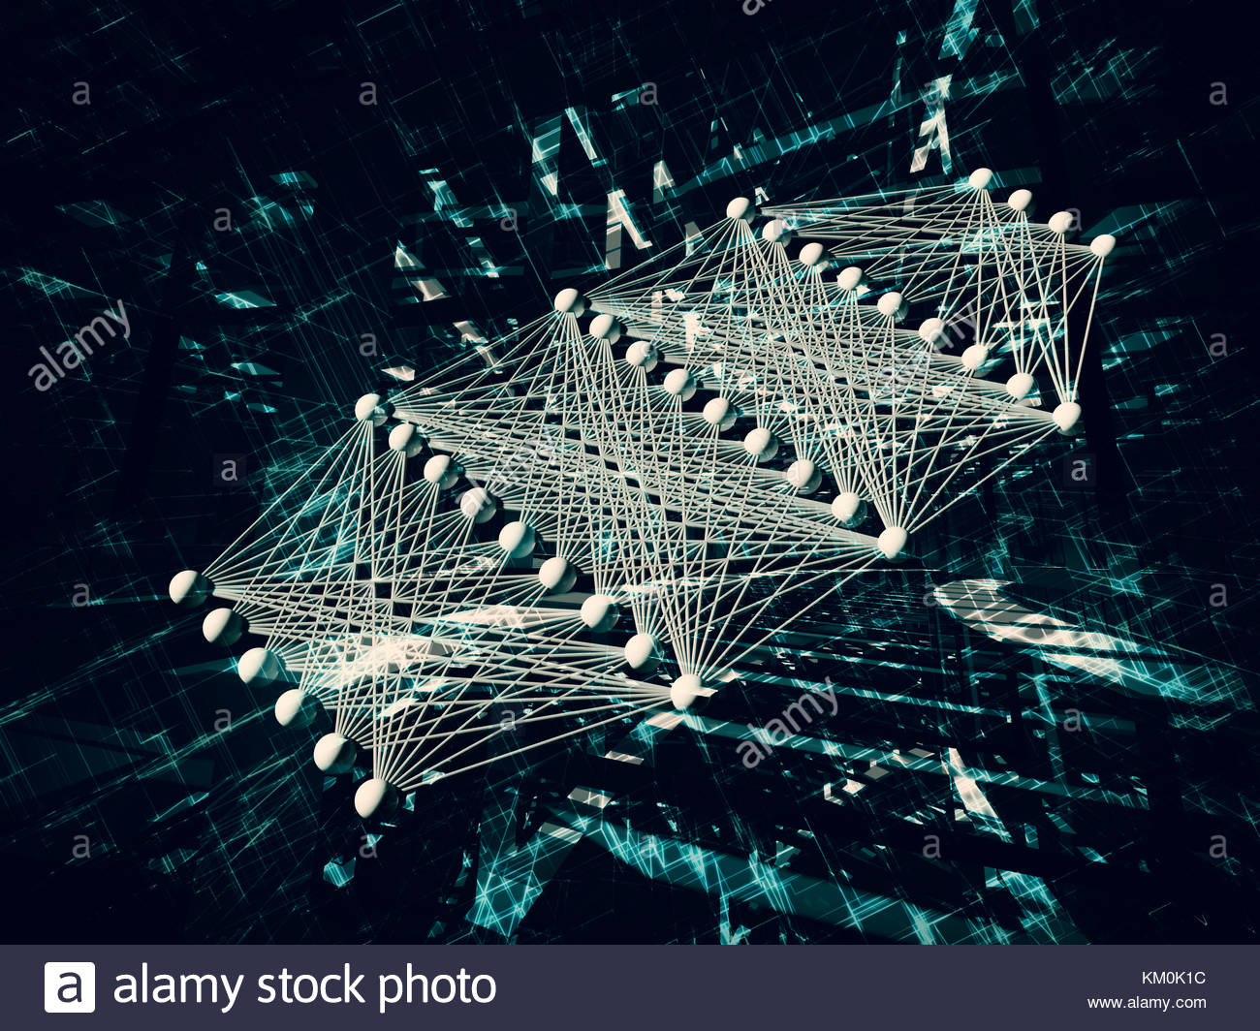

THANK YOU!!!
ANY QUESTIONS?

